Slide 1
Using Copilot Studio to Create Job Specific AI Agents
Kevin O’Bryan

Slide 2

Agenda
Introduction to Copilot Agents
Explanation and basics
Autonomous Agents
Building a Basic Agent
Demo Autonomous Agents

Slide 3
What is Copilot Agents?
Specialized AI assistants designed to connect to your organization’s knowledge and data sources.
Custom AI to automate and execute business processes, working with you and on your behalf.

Slide 4
Why should I use Copilot Agents?
Agents leverage cutting-edge AI to provide users with intelligent assistance across various Microsoft 365 applications.
Allows further consistency and improvements in accuracy in tasks. Seamlessly integrating with Web and Work tabs of Copilot Chat, and workflows you already use.
They allow organizations to streamline work and automations at the global or individual level.
Able to create and publish agents to all kinds of channels, apps, and websites.

Slide 5
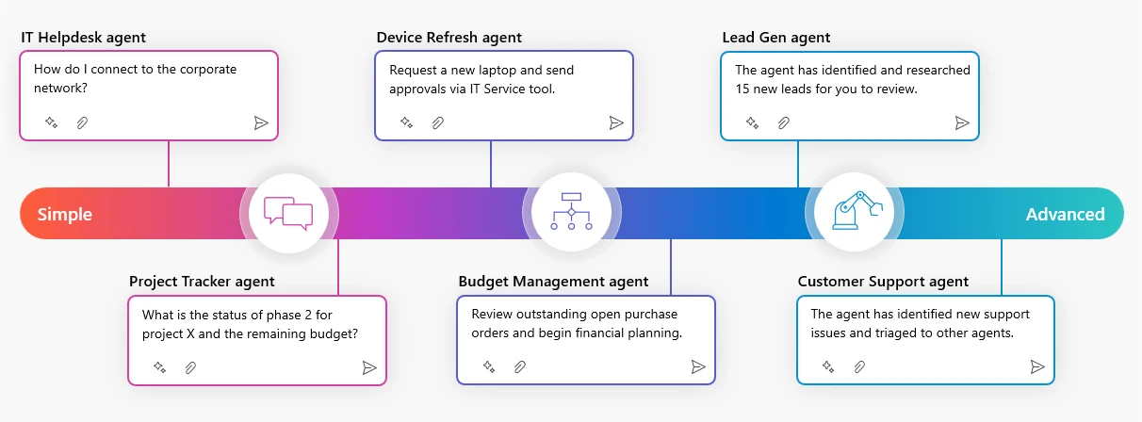

Slide 6
Copilot Autonomous Agents
Agents can automatically respond to signals across your business and initiate tasks via Orchestration behavior.
Each business process can have different paths since agents create dynamic plans on the fly dynamically to handle and complete tasks.
Admins can view the logic path of the Agent to understand the methods, processes, and context in detailed steps to debug the automations.

Slide 7
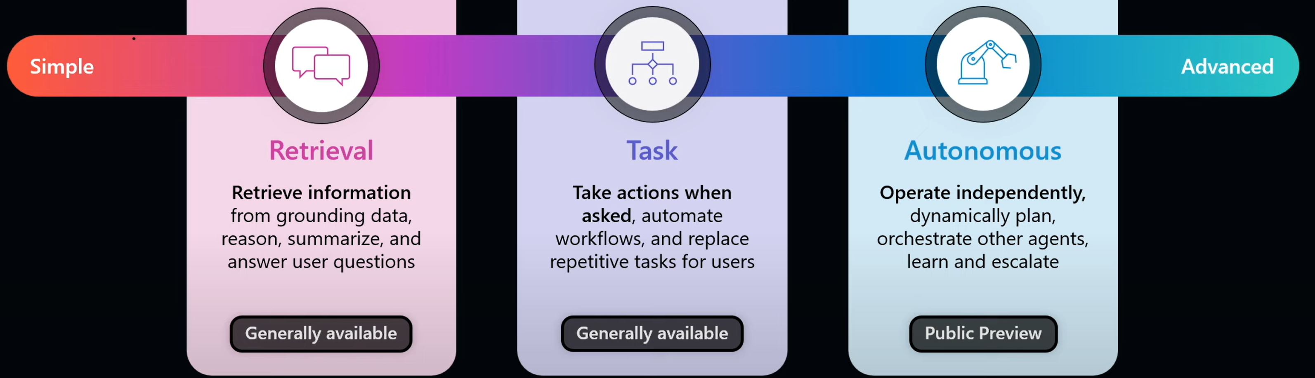

Slide 8
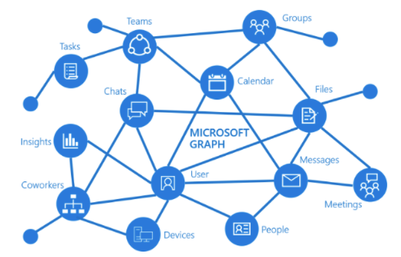
Requirements to set up Agents
Licensing
Pay-as-you-go
Message packs
Copilot Studio in Microsoft 365 Copilot
Governance and data security
Per-user level access

